Slide 1
Physical activity
Heather O’Neil and Lyndsey Housden
May 7th, 2025

Slide 2
Overcoming MS Program
Overcoming
MS
Diet
Sun & Vitamin D
Physical activity
Stress Management
Medication
Change your
Life, for Life
Family Health

Slide 3
Overview
General Benefits of Physical Activity
Physical Activity and Brain Health
Recommendations
4. Lyndsey’s story
5. Stretch Break
6. Q&A

Slide 4
Physical activity influences many brain chemicals, including those that give you energy, alleviate worry and help you bond with others. It reduces inflammation in the brain (…) The mind-altering effects of exercise are even embedded in your musculature.
Kelly McGonigal , The Joy of Movement: How exercise helps us find happiness, hope, connection, and courage

Slide 5
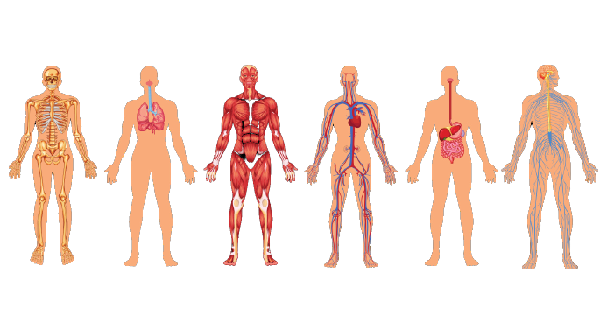
How our body works
Homeostasis: the constant tweaking to keep us safe.
Different systems manage their own business, but homeostasis also requires a lot of communication between systems.
Brain is the facilitator.

Slide 6
Myokines
Different muscle fibres release different myokine types.
These have different effects.
Myokines also protect against pro-inflammatory effects of adipokines.
Byunghun So et el, Exercise-induced myokines in health and metabolic diseases, Integrative Medicine Research, Volume 3, Issue 4, December 2014, 172-179

Slide 7
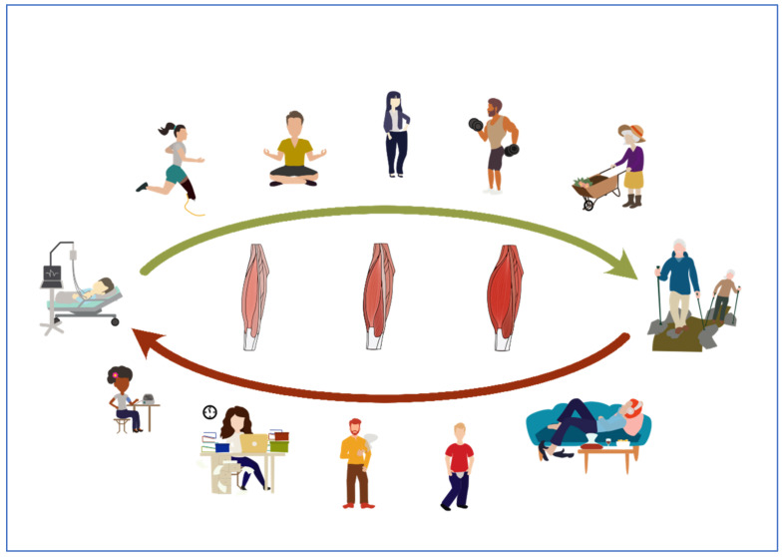
Factors influencing myokine production
Physical activity
Body weight management
Stress reduction
Nutrition
Daily movement
Other lifestyle factors
Vice versa, an unhealthy lifestyle could lead to loss of muscle mass and an impaired myokine production.
Beate E M Zunner, Myokines and Resistance Training: A Narrative Review, International Journal of Molecular Sciences, 2022 Apr; 23(7): 3501.

Slide 8
Physical Activity activates:
the central nervous system
the peripheral nervous system
the endocrine system
the skeletal muscle system
the cardiovascular system
It does so in a very integrative and systematic manner and by repeatedly exposing yourself to bouts of exercise, all these systems adapt in an integrated manner. They learn how to work better. They grow stronger. They grow better. Presentation by Professor Robert Motl, Benefits, Safety and Guideline for Exercise in MS, May 22nd 2023

Slide 9
Brain health
Simply moving your body, has immediate, long-lasting and protective benefits for your brain. And that can last for the rest of your life.
Wendy Suzuki, Prof. of neuroscience and psychology at New York University Center for Neural Science

Slide 10
Key areas
Prefrontal cortex: critical for decision-making, focus, attention and personality.
Hippocampus: critical for our ability to form and retain new long-term memories for facts and events.

Slide 11
Physical activity & neuroplasticity
Our brain can strengthen or find new neural pathways
Strong neural pathways = stronger muscles & improved mobility.
Neuroplasticity can happen for anyone with MS regardless of their level of disability or year of diagnosis.
Give your brain a chance to find a new neural pathway by repeating the exercise, even with no movement. One repetition equals one bout of effort.
Hawley, Dr. Gretchen. The MSing Link: The Essential Guide to Improve Walking, Strength & Balance for People with Multiple Sclerosis (2023)

Slide 12
A disease-modifying intervention?
Exercise is a safe and well-recognized symptomatic treatment option that has beneficial effects on a variety of symptoms in persons with MS.
However, recent evidence suggests that exercise may also have disease-modifying effects in persons with MS and may even have preventive effects by lowering the disease risk.
Professor Ulrik Dalgas, Exercise as Medicine in Multiple Sclerosis—Time for a Paradigm Shift, Current Neurology and Neuroscience Reports (2019)

Slide 13
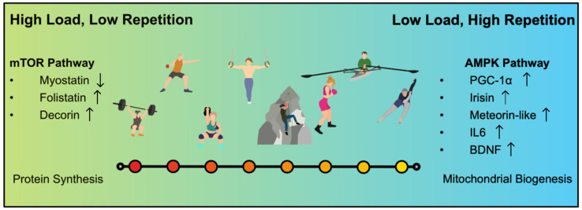
Resistance training & myokines
Beate E M Zunner, Myokines and Resistance Training: A Narrative Review, International Journal of Molecular Sciences, 2022 Apr; 23(7): 3501.

Slide 14
Aerobic training & grey matter
People with MS tend to have:
Research shows:
Significant lower VO2 max
Lower 6 min walk test results
Impaired Heart Rate Reserve
Widespread pattern of Grey Matter atrophy
Modifications of GM areas (especially involved in sensorimotor control, visual processing, and cognitive functions)
Possible neuroprotective role with a reduced atrophy progression rate.

Slide 15
Stretching, mental wellbeing & inflammation
Mental wellbeing
Inflammation
Stretching helps to release endorphins, dopamine and serotonin, which help to motivate us, fight off depression and decrease anxiety.
Experiment with ‘yoga rats’: higher concentration of resolvins in the tissues after stretching, which turns off inflammation.
Resolvins enter the blood and might clear inflammation anywhere in body.

Slide 16
HOLISM Study
HOLISM study since 2011 with 2,500 participants
Results show that exercise was associated with:
less disability.
better quality of life.
lower risk of depression.
Exercise has protective effects; helps to manage symptoms; preserves brain volume ; has disease-modifying benefits

Slide 17
Physical activity & quality of life
Mean score

Slide 18
Physical activity to manage MS symptoms
Increases muscle strength
Improves sexual function
Improves bowel &
bladder function
Improves walking speed
Increases energy levels
Lower risk of depression
Improves mood
Better quality of life
Reduced relapse rate
Associated with less disability

Slide 19
Overcoming MS recommendation
How often? | 2 to 3 days per week to start, then 2 to 5 days per week
How much? | Gradually increase to 30 min
How hard? | Moderate intensity
Note: | Include strengthening. Increase repetitions / intensity as the body adapts. Start slow – Build over time.

Slide 20
Not a ‘one size fits all’
You’re not doing any PA
You already have a routine
Start with 5 min in total and slowly build up to 30 min
Start with 2 ‘sessions’ a week
Focus on moving more
Build to 30 min per session
Build up from 2 to 5 sessions per week
Include strenghening as well as aerobics exercise
ALWAYS
Prioritise safety
Don’t overdo it
Focus on REGULARITY & PROGRESSION

Slide 21
Dr Gretchen’s recommendation: 6 out of 10
Strengthening
Endurance
Stretching
Balance
Coordination
Aerobic exercise
Speed
Implementing daily movement
HIIT
Classes
Hawley, Dr. Gretchen. The MSing Link: The Essential Guide to Improve Walking, Strength & Balance for People with Multiple Sclerosis

Slide 22
Making time for movement in your life is not a luxury, and it’s not self-indulgent. It’s a necessity. Caroline Williams, Move! The New Science of Body Over Mind

Slide 23
References
Kelly McGonigal, The Joy of Movement: How exercise helps us find happiness, hope, connection, and courage by Kelly McGonigal
Byunghun So et al, Exercise-induced myokines in health and metabolic diseases, Integrative Medicine Research, Volume 3, Issue 4, December 2014, 172-179
Presentation by Professor Robert Motl, Benefits, Safety and Guideline for Exercise in MS, May 22nd 2023 on YouTube
Caroline Williams, Move! The New Science of Bodye Over Mind
Rai Mamta & Demontis Fabio, Muscle-to-Brain Signaling Via Myokines and Myometabolites in Brain Plasticity, vol. 8, no. 1, pp. 43-63, 2022
Beate E M Zunner, Myokines and Resistance Training: A Narrative Review, International Journal of Molecular Sciences, 2022 Apr; 23(7): 3501.
Professor Ulrik Dalgas, Exercise as Medicine in Multiple Sclerosis—Time for a Paradigm Shift, Current Neurology and Neuroscience Reports (2019)
Hawley, Dr. Gretchen. The MSing Link: The Essential Guide to Improve Walking, Strength & Balance for People with Multiple Sclerosis
Kalb, R. et al, Exercise and lifestyle physical activity recommendations for people with multiple sclerosis throughout the disease course, Multiple Sclerosis Journal, 2022 vol.26(12), 1459-1469.

Slide 24
Thank You!
overcomingms.org
Notes:
NEXT, during the retreat, we’ll look at more PRACTICAL questions, ie HOW TO CHOOSE YOUR PROGRAMME< STAY WITH IT & BUILD ON IT

